Slide 1
Real-Time Web Functionality
Course Code: CSC 4164
Course Title: ADVANCED PROGRAMMING WITH .NET
Dept. of Computer Science
Faculty of Science and Technology
Lecture No: | 16 | Week No: | 12 & 13 | Semester:
Lecturer: | Victor Stany Rozario, stany@aiub.edu

Slide 2
Lecture Outline
Stateless VS Persistent connection
Different asynchronous communication (AJAX polling, long polling, forever frame, event-source)
Web sockets, RPC and HUB
Introduction to SignalR
Installing and configuring SignalR
Implementing server side (HUB)
Implementing client side (JavaScript)

Slide 3
What is SignalR?
ASP.NET SignalR is a library for ASP.NET developers that simplifies the process of adding real-time web functionality to applications. Real-time web functionality is the ability to have server code push content to connected clients instantly as it becomes available, rather than having the server wait for a client to request new data.
SignalR can be used to add any sort of "real-time" web functionality to your ASP.NET application. While chat is often used as an example, you can do a whole lot more. Any time a user refreshes a web page to see new data, or the page implements long polling to retrieve new data, it is a candidate for using SignalR. Examples include dashboards and monitoring applications, collaborative applications (such as simultaneous editing of documents), job progress updates, and real-time forms.
SignalR also enables completely new types of web applications that require high frequency updates from the server, for example, real-time gaming.

Slide 4
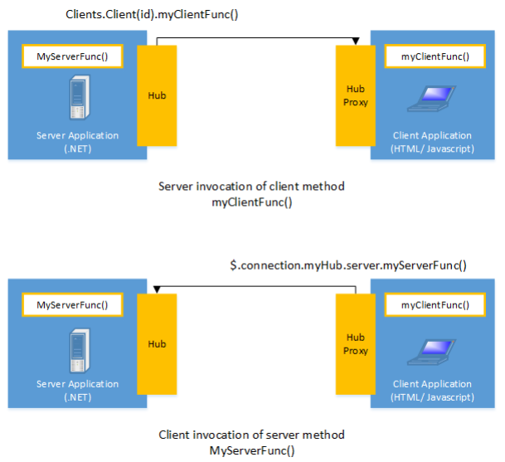
SignalR..
SignalR provides a simple API for creating server-to-client remote procedure calls (RPC) that call JavaScript functions in client browsers (and other client platforms) from server-side .NET code. SignalR also includes API for connection management (for instance, connect and disconnect events), and grouping connections.

Slide 5
SignalR..
SignalR handles connection management automatically, and lets you broadcast messages to all connected clients simultaneously, like a chat room. You can also send messages to specific clients. The connection between the client and server is persistent, unlike a classic HTTP connection, which is re-established for each communication.
SignalR supports "server push" functionality, in which server code can call out to client code in the browser using Remote Procedure Calls (RPC), rather than the request-response model common on the web today. SignalR applications can scale out to thousands of clients using built-in, and third-party scale-out providers.

Slide 6
SignalR..
Built-in providers include:
Service Bus
SQL Server
Redis
Third-party providers include:
NCache.
SignalR is open-source, accessible through GitHub.

Slide 7
SignalR and WebSocket
SignalR uses the new WebSocket transport where available and falls back to older transports where necessary. While you could certainly write your app using WebSocket directly, using SignalR means that a lot of the extra functionality you would need to implement is already done for you.
Most importantly, this means that you can code your app to take advantage of WebSocket without having to worry about creating a separate code path for older clients. SignalR also shields you from having to worry about updates to WebSocket, since SignalR is updated to support changes in the underlying transport, providing your application a consistent interface across versions of WebSocket.

Slide 8
Transports and fallbacks
SignalR is an abstraction over some of the transports that are required to do real-time work between client and server. A SignalR connection starts as HTTP, and is then promoted to a WebSocket connection if it is available.
WebSocket is the ideal transport for SignalR, since it makes the most efficient use of server memory, has the lowest latency, and has the most underlying features (such as full duplex communication between client and server), but it also has the most stringent requirements: WebSocket requires the server to be using Windows Server 2012 or Windows 8, and .NET Framework 4.5.
If these requirements are not met, SignalR will attempt to use other transports to make its connections

Slide 9
HTML 5 transports
These transports depend on support for HTML 5. If the client browser does not support the HTML 5 standard, older transports will be used.
WebSocket (if both the server and browser indicate they can support Websocket). WebSocket is the only transport that establishes a true persistent, two-way connection between client and server. However, WebSocket also has the most stringent requirements; it is fully supported only in the latest versions of Microsoft Internet Explorer, Google Chrome, and Mozilla Firefox, and only has a partial implementation in other browsers such as Opera and Safari.
Server Sent Events, also known as EventSource (if the browser supports Server Sent Events, which is basically all browsers except Internet Explorer.)

Slide 10
Comet transports
The following transports are based on the Comet web application model, in which a browser or other client maintains a long-held HTTP request, which the server can use to push data to the client without the client specifically requesting it.
Forever Frame (for Internet Explorer only). Forever Frame creates a hidden IFrame which makes a request to an endpoint on the server that does not complete. The server then continually sends script to the client which is immediately executed, providing a one-way realtime connection from server to client. The connection from client to server uses a separate connection from the server to client connection, and like a standard HTTP request, a new connection is created for each piece of data that needs to be sent.
Ajax long polling. Long polling does not create a persistent connection, but instead polls the server with a request that stays open until the server responds, at which point the connection closes, and a new connection is requested immediately. This may introduce some latency while the connection resets.
For more information on what transports are supported under which configurations, see Supported Platforms.

Slide 11
Transport selection process
The following list shows the steps that SignalR uses to decide which transport to use.
1. If the browser is Internet Explorer 8 or earlier, Long Polling is used.
2. If JSONP is configured (that is, the jsonp parameter is set to true when the connection is started), Long Polling is used.
3. If a cross-domain connection is being made (that is, if the SignalR endpoint is not in the same domain as the hosting page), then WebSocket will be used if the following criteria are met:
The client supports CORS (Cross-Origin Resource Sharing). For details on which clients support CORS, see CORS at caniuse.com.
The client supports WebSocket
The server supports WebSocket
If any of these criteria are not met, Long Polling will be used. For more information on cross-Monitoring transports domain connections, see How to establish a cross-domain connection.
4. If JSONP is not configured and the connection is not cross-domain, WebSocket will be used if both the client and server support it.
5. If either the client or server do not support WebSocket, Server Sent Events is used if it is available.
6. If Server Sent Events is not available, Forever Frame is attempted.
7. If Forever Frame fails, Long Polling is used.

Slide 12
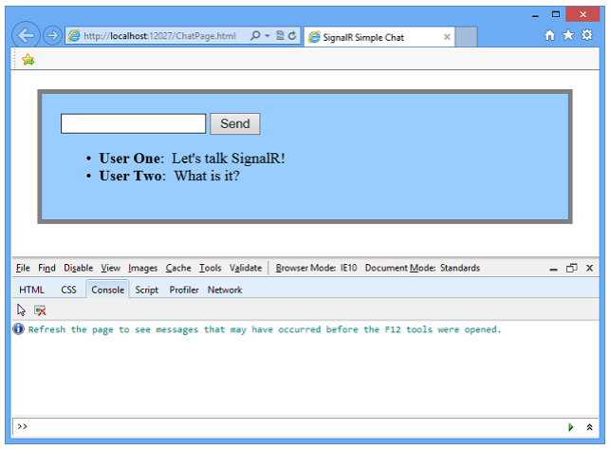
Monitoring transports
You can determine what transport your application is using by enabling logging on your hub and opening the console window in your browser. To enable logging for your hub's events in a browser, add the following command to your client application:
$.connection.hub.logging = true;
In Internet Explorer, open the developer tools by pressing F12, and click the Console tab

Slide 13
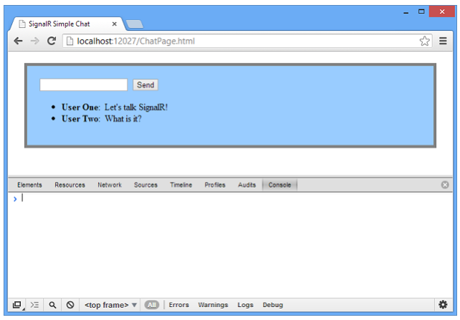
Monitoring transports
In Chrome, open the console by pressing Ctrl+Shift+J

Slide 14
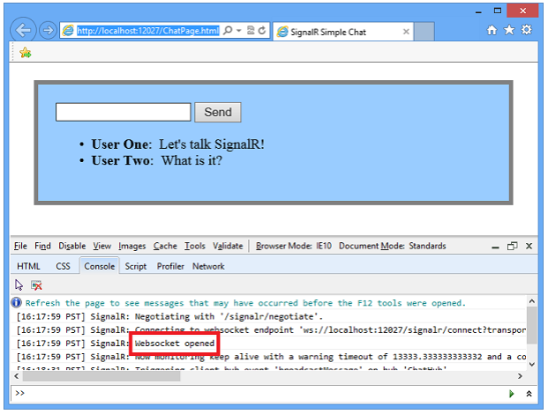
Monitoring transports
With the console open and logging enabled, you'll be able to see which transport is being used by SignalR.

Slide 15
Specifying a transport
Negotiating a transport takes a certain amount of time and client/server resources. If the client capabilities are known, then a transport can be specified when the client connection is started. The following code snippet demonstrates starting a connection using the Ajax Long Polling transport, as would be used if it was known that the client did not support any other protocol:
connection.start({ transport: 'longPolling' });
You can specify a fallback order if you want a client to try specific transports in order. The following code snippet demonstrates trying WebSocket, and failing that, going directly to Long Polling.
connection.start({ transport: ['webSockets','longPolling'] });

Slide 16
Specifying a transport
The string constants for specifying transports are defined as follows:
webSockets
foreverFrame
serverSentEvents
longPolling

Slide 17
Connections and Hubs
The SignalR API contains two models for communicating between clients and servers: Persistent Connections and Hubs.
A Connection represents a simple endpoint for sending single-recipient, grouped, or broadcast messages. The Persistent Connection API (represented in .NET code by the PersistentConnection class) gives the developer direct access to the low-level communication protocol that SignalR exposes. Using the Connections communication model will be familiar to developers who have used connection-based APIs such as Windows Communication Foundation.
A Hub is a more high-level pipeline built upon the Connection API that allows your client and erver to call methods on each other directly. SignalR handles the dispatching across machine boundaries as if by magic, allowing clients to call methods on the server as easily as local methods, and vice versa. Using the Hubs communication model will be familiar to developers who have used remote invocation APIs such as .NET Remoting. Using a Hub also allows you to pass strongly typed parameters to methods, enabling model binding.

Slide 18
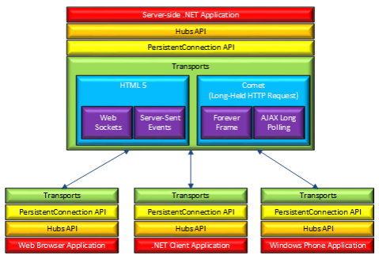
Architecture diagram
The following diagram shows the relationship between Hubs, Persistent Connections, and the underlying technologies used for transports.

Slide 19
How Hubs work
When server-side code calls a method on the client, a packet is sent across the active transport that contains the name and parameters of the method to be called (when an object is sent as a method parameter, it is serialized using JSON). The client then matches the method name to methods defined in client-side code.
If there is a match, the client method will be executed using the deserialized parameter data. The method call can be monitored using tools like Fiddler. The following mage shows a method call sent from a SignalR server to a web browser client in the Logs pane of Fiddler. The method call is being sent from a hub called MoveShapeHub and the method being invoked is called updateShape .

Slide 20
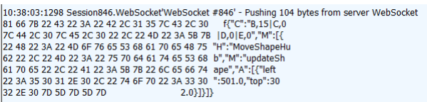
How Hubs work
In this example, the hub name is identified with the H parameter; the method name is identified with the M parameter, and the data being sent to the method is identified with the A parameter. The application that generated this message is created in the High-Frequency Realtime tutorial.

Slide 21
Choosing a communication model
Most applications should use the Hubs API. The Connections API could be used in the following circumstances:
The format of the actual message sent needs to be specified.
The developer prefers to work with a messaging and dispatching model rather than a remote invocation model.
An existing application that uses a messaging model is being ported to use SignalR.

Slide 22
Demonstration of SignalR

Slide 23
Introduction of ASP.NET SignalR
In here, I am using the ASP.NET SignalR library in the latest MVC 5 project template. Let me give you a glimpse of SignalR, it is a library that adds real-time web functionality to the ASP.NET applications. Now, what is this real-time functionality? It is used to access the server code and push the content to the connected clients instantly instead of the server waiting for the client's request.
In that context, I am developing an ASP.NET Web application using the MVC Project template and in it using a real-time web application with ASP.NET SignalR.
Prerequisites:
I am using Visual Studio 2013. There are some prerequisites to develop the application:
Visual Studio 2010 SP1 or Visual Studio 2012.
ASP.NET and Web Tools 2012.2
Let's create an application for SignalR development using the following sections:
MVC 5 Application
Code Execution

Slide 24
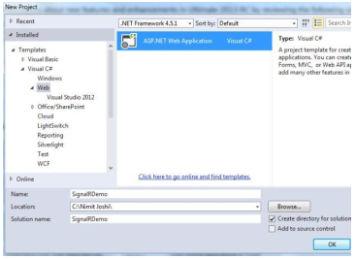
MVC 5 Application
Step 1: Open Visual Studio 2013 and create a New Project.

Slide 25
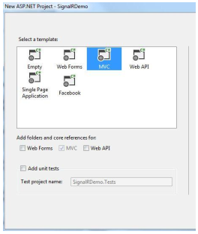
MVC 5 Application
Step 2: Select MVC project template.

Slide 26
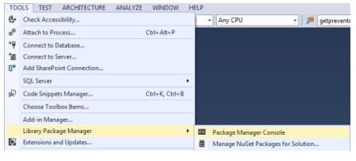
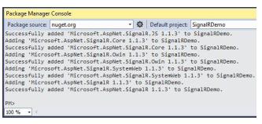
MVC 5 Application
Step 3: Open the Package Manager Console
And write the following command: install-package Microsoft.AspNet.SignalR

Slide 27
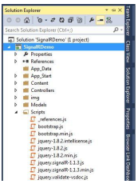
MVC 5 Application
Step 4: You can see in your Solution Explorer that the SignalR was successfully added to your application.

Slide 28
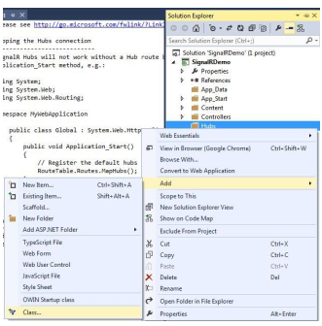
MVC 5 Application
Step 5: Add a new folder named Hubs in your application and add a class in it.

Slide 29
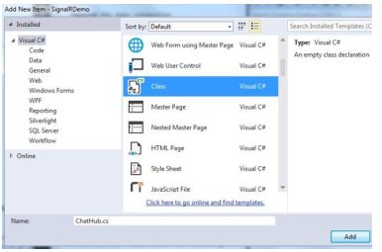
MVC 5 Application
Give the name of your class ChatHub as shown below:

Slide 30
MVC 5 Application
Step 5: Add the following code in the class:
using Microsoft.AspNet.SignalR; namespace SignalRDemo.Hubs { public class ChatHub : Hub { public void LetsChat(string Cl_Name, string Cl_Message) { Clients.All.NewMessage(Cl_Name, Cl_Message); } } }

Slide 31
MVC 5 Application
Step 6: Open the Global.asax file and modify the Applicatio_Start() method as shown below:
public class MvcApplication : System.Web.HttpApplication { protected void Application_Start() { RouteTable.Routes.MapHubs(); AreaRegistration.RegisterAllAreas(); FilterConfig.RegisterGlobalFilters(GlobalFilters.Filters); RouteConfig.RegisterRoutes(RouteTable.Routes); BundleConfig.RegisterBundles(BundleTable.Bundles); } }

Slide 32
MVC 5 Application
Step 7: Open your HomeController.cs file and modify it as shown below:
public ActionResult Contact() { ViewBag.Message = "Your contact page."; return View(); } public ActionResult Chat() { ViewBag.Message = "Your chat page"; return View(); }

Slide 33
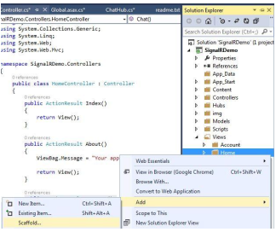
MVC 5 Application
Step 8: Generate the view for the Chat method as shown in the following parts: Select Home folder and right-click to add Scaffold

Slide 34
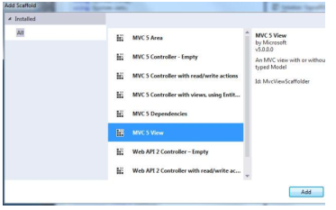
MVC 5 Application
Select MVC 5 View in the Add Scaffold wizard

Slide 35
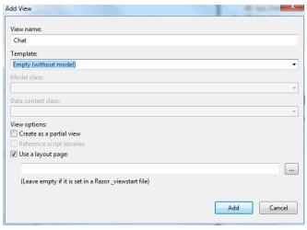
MVC 5 Application
Do as directed in the following image:

Slide 36
MVC 5 Application
Step 9: Add the following code in the Chat.cshtml file:
@{ ViewBag.Title = "Chat"; }
<hgroup> <h2>@ViewBag.Title.</h2> <h3>@ViewBag.Message</h3> </hgroup> <div class="container"> <input type="text" id="TxtMessage" /> <input type="button" id="BtnSend" value="Send" /> <input type="hidden" id="UserName" /> <ul id="Chats"></ul> </div>

Slide 37
MVC 5 Application
Step 9: Add the following code in the Chat.cshtml file:
@section scripts { <script src="~/Scripts/jquery.signalR-1.1.3.js"></script> <script src="~/signalr/Hubs"></script> <script> $(function () { var chat = $.connection.chatHub; chat.client.NewMessage=function(Cl_Name, Cl_Message) { $('#Chats').append('<li><strong>' + htmlEncode(Cl_Name) + '</strong>: ' + htmlEncode(Cl_Message) + '</li>'); }; $('#UserName').val(prompt('Please Enter Your Name:', ''));
$('#TxtMessage').focus(); $.connection.hub.start().done(function () { $('#BtnSend').click(function () { chat.server.LetsChat($('#UserName').val(), $('#TxtMessage').val()); $('#TxtMessage').val('').focus(); }); }); }); function htmlEncode(value) { var encodedValue = $('<div />').text(value).html(); return encodedValue; } </script> }

Slide 38
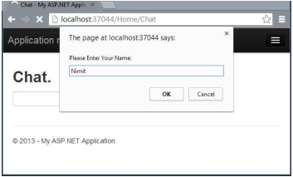
Code Execution
Save all your application and debug the application. Use the following procedure. Step 1: Debug your application. Open /Home/Chat in your browser like: http://localhost:12345/Home/Chat Step 2: Enter your name in the promp

Slide 39
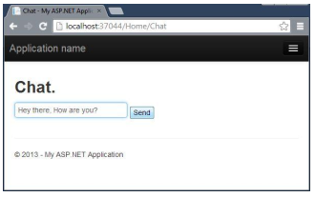
Code Execution
Step 3: Enter message and send

Slide 40
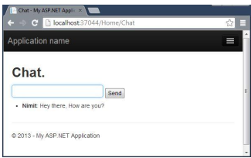
Code Execution
After clicking on Send:

Slide 41
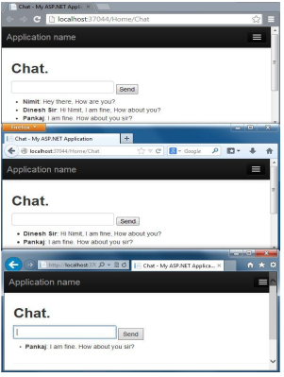
Code Execution
Step 4: Copy the browser URL and open more browsers, paste the URL in the address bar and do the same thing as above.

Slide 42
Books
Pro ASP.NET Web API: HTTP Web Services in ASP.NET -by Tugberk Ugurlu, Alexander Zeitler, Ali Kheyrollahi
Programming ASP .Net MVC 5 – by Nimit Joshi

Slide 43
References
https://www.tutorialsteacher.com
https://docs.microsoft.com/en-us/aspnet/web-api

